Slide 1


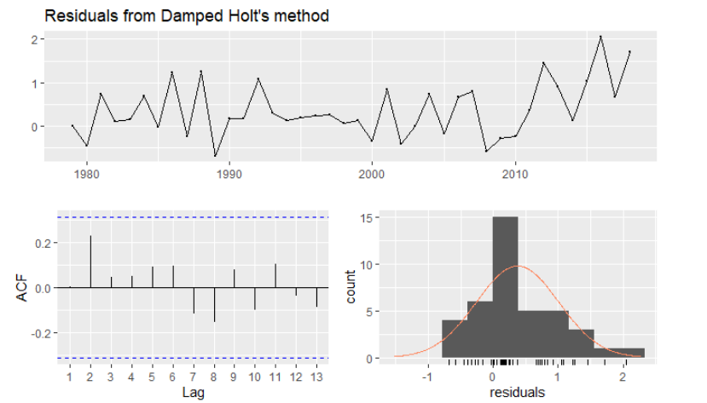
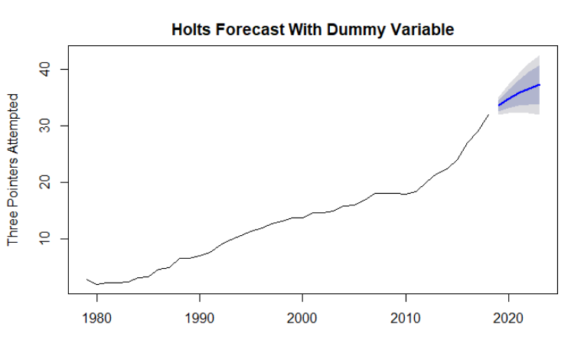
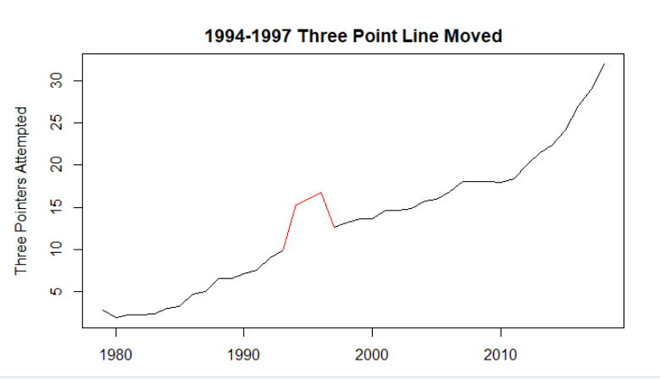
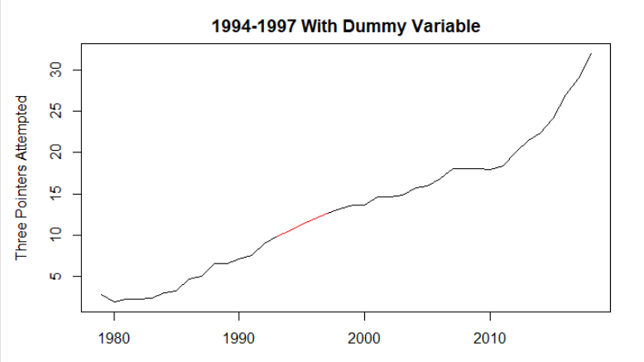
The Future of the Three-Pointers in the NBA Justin Kringler Concordia College, Moorhead, Minnesota Advisor: Dr. John Reber, Department of Mathematics
Introduction and Objective
The NBA has a culture of it’s own. The NBA has been continuously changing since it was established in 1946. Continuous rule changes from what is considered to be a travel to the introduction of three-point line. Offense that went from feeding the post to launching three pointers. Defense that went from hustle plays to flashy blocks. Because the NBA is continuously changing it led me to want to find out the direction the NBA is heading in regards to three-pointers. I am trying to find out if the culture of the NBA is shifting towards a three point dominant era that is proficient on maximizing the efficiency in scoring. I also would like to try and predict the upcoming average three pointers attempted per game from one team for the next five seasons.
Analysis and Results
The results of the forecasts both looked promising, but Auto-ARIMA can not account for the possible rule changes that may happen in the future or the fact that eventually the amount of three-pointers being shot would cap off because of this the Holts forecast appeared to be better in terms of the high and low 95 percent confidence intervals.
The best forecast in terms of the more realistic and the most reliable is the Holts Forecast. For both of these forecasts the dummy variable put in place helped significantly and bettered the results by making the forecast more realistic and a better confidence interval. The residuals were also cleaner once the dummy variable was introduced.
Auto-ARIMA | High and Low 95 | Holts | High and Low 95
2019 | 33.23 - 35.48 | 2019 | 32.04 – 35.10
2020 | 34.83 – 38.92 | 2020 | 32.30 – 37.36
2021 | 36.36 – 42.51 | 2021 | 32.35 – 39.33
2022 | 37.67 – 46.09 | 2022 | 32.22 – 41.07
2023 | 38.97 – 49.87 | 2023 | 31.97 – 42.62
Methods
This forecast was made in R Studios with reference to an excel file that had the average statistics for the NBA for all seasons since the three-point line was introduced. There was a problem with the data not being consistent since the NBA decided to move the three-point line closer in 1994 but moved it back out in 1997. This required a dummy variable to fix the data and make it more consistent. For every forecast made there were two forecast prior, one including the dummy variable and one without the dummy variable. This way the most accurate forecast would be for sure used. The two forecast functions used were Auto-ARIMA and Holts. The Auto-ARIMA was meant to find the best model that supported the data, while the Holts forecast was meant to depict what I thought the forecast should look like based off my knowledge of the NBA. The Auto-ARIMA forecast used two variables to help improve the forecast. The two variables were averages points scored in a game by a team, and the average three -point percent.
Figure 4: The residuals of the Holts forecast.
Figure 2: The high and low 95 percent confidence interval for the Auto-ARIMA and Holts forecast.
Discussion
Overall I am very happy with both the Auto-ARIMA and Holts Forecast used because they both present plausible predictions that could occur for the next five seasons of the NBA. The Auto-ARIMA forecasts two external variables proved to strengthen the model when compared to the model without the external variables. The residuals were a lot cleaner, the lag plot did not have any lines outside the box, and the model was more realistic. Another thing that the Auto-Arima forecast did well was maintain a good confidence window. Without the dummy variable and external variables the confidence window was too big and not realistic. Based off of trends from the data and viewing the NBA, it is pretty safe to say the NBA’s culture is shifting to a three-point dominant era that capitalizes on maximizing points per game through becoming more accurate from the three-point line
Bibliography
https://www.basketball-reference.com/leagues/NBA_stats_per_game.html
Figure 3: Holts forecast for the average amount of thee-pointers attempted in a game by one team for the next five seasons.
Figure 1: Average three pointers attempted in a game each year with and without a dummy variable.

